Slide 1

SCHOOL OF ENGINEERING SCIENCES
DEPARTMENT OF BIOMEDICAL ENGINEERING
MONITORING OXYGEN SATURATION (Sp02) AND HEART RATE VITAL SIGNS USING FITBIT VERSA 2 AND XIAOMI MI BAND 6 WEARABLE DEVICES
Date: 12TH October, 2022
SUPERVISOR: PROF. ELSIE EFFAH KAUFMANN
CO-SUPERVISOR: DR.GODFREY MILLS
DEPARTMENT OF BIOMEDICAL ENGINEERING
DEPARTMENT OF COMPUTER ENGINEERING

Slide 2
COLLABORATORS
DEPARTMENT OF BIOMEDICAL ENGINEERING
DEPARTMENT OF COMPUTER ENGINEERING
PROF. ELSIE EFFAH KAUFMANN (SUPERVISOR)
DR. GODFREY MILLS (CO-SUPERVISOR)
DANIELLE PATRICIA QUAYE
BISMARK YAO AKWETEY
RICHMOND TACKIE
SAMUEL MPAABA WINBONO MBA
NORTHWESTERN UNIVERSITY
DR. HASSAN GHOMRAWVI
DR. MATTHEW GLUCKSBURG
SPECIALIST AT KORLE-BU TEACHING HOSPITAL DR. WILLIAM APPEADU-MENSAH

Slide 3
PROJECT BACKGROUND
Wearable technology (WT) encompasses a myriad of devices worn directly on or loosely attached to a person (Godfrey et al., 2018)
WT can be subdivided into two categories;
Primary: those operating independently and functioning as central connectors for other devices
Secondary: those that record specific actions or execute a measurement
Wearable Health Devices (WHD) are an emerging WT that enable continuous monitoring of human vital signs in a clinical environment (Di Rienzo et al., 2005)

Slide 4
PROJECT BACKGROUND
Vital signs are physiological data obtained from the human body, which describes the state of health of an individual.
Continuous measuring of vital signs enable changes in trend of the data to be noticed which can prevent complications that may lead to death
Overall, five traditional vital signs have a major importance to be measured continuously. They include;
VITAL SIGN | NORMAL RANGE, School-Age (6 -11 yrs.) | NORMAL RANGE, Adult
Body Temperature | 35.5 – 37.5 degrees Celsius | 97.8°F to 99.1°F (36.5°C to 37.3°C); average 98.6°F (37°C)
Blood pressure | Systolic; 97 -115mmHg Diastolic; 57 – 76mmHg | Blood pressure: 90/60 mm Hg to 120/80 mm Hg
Heart Rate | 75 – 118 beats per minute | 60 to 100 beats per minute
Blood oxygen saturation | > 92% | >95%
Respiratory rate | 18 – 25 breaths per minute | 12 to 18 breaths per minute

Slide 5
PROJECT BACKGROUND
These bio-signals are grouped according to the location on the body they can be taken from (Khan et al., 2016).
Temperature, Heart rate and Pulse Oxygenation can be taken from the wrist
Blood pressure measurement and bioelectronics measurements can be taken from the arm.
Post operative complications may arise if these vital signs are not continuously monitored and this may lead to death (Weenk et al., 2017)

Slide 6
PROJECT BACKGROUND
Results of an investigation conducted on the limitations of basic vital signs monitoring
84%
75%
60%
PATIENTS EXHIBIT DETERIORATION SIGNS PRECEEDING CARDIO-PULMONARY ARREST
Within 8 hours
ADVERSE EVENTS AND PREVENTABLE DEATHS OCCUR OUTSIDE THE ICU IN UNMONITORED BEDS
PATIENTS IN THE HOSPITAL ARE NOT CONTINOUSLY MONITORED

Slide 7
PROJECT BACKGROUND
An investigation on the number of retrieved scientific papers related with WHDs and a specific physiological sign.
10
13
6
5
3
2
2
2
2010 - 2013
2
2
2
1
1
BG
SPO2
ECG
0
ECG
BT
BP
RR
HR
BT
BP
RR
BG
HR
SPO2
MEDICAL
ACTIVITIES

Slide 8
PROJECT BACKGROUND
An investigation on the number of retrieved scientific papers related with WHDs and a specific physiological sign.
83
14
15
23
12
17
17
10
8
7
2014 - 2017
6
3
5
BG
HR
2
ECG
BG
HR
ECG
BT
BP
RR
SPO2
BT
BP
RR
SPO2
MEDICAL
ACTIVITIES

Slide 9
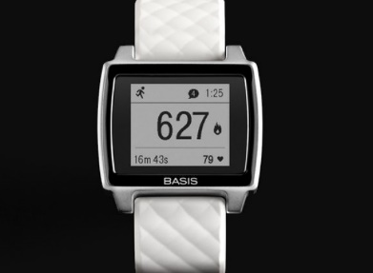
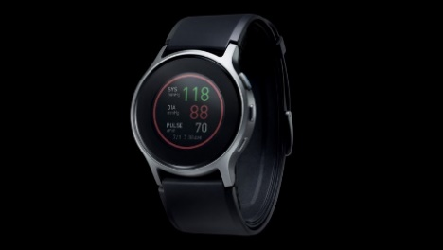
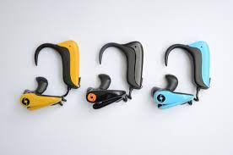
EXISTING WORKS/BENCHMARKING
PARAMETER | DEVICE TYPE | DEVICE
Heart rate, Sleep monitoring, Skin temperature and Perspiration | Wrist watch | Basis Peak ($199) (Duffy J., 2016)
Blood Pressure | Wrist watch | Valencell (Raleigh N., 2021)
Oxygen Stauration, Heart rate | Ear accessory device | SensoTRACK ear Sensor (Jung S., 2014)

Slide 10
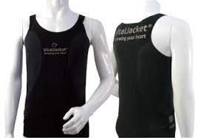
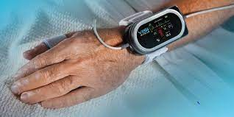
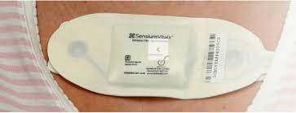
EXISTING WORKS/BENCHMARKING
PARAMETER | DEVICE TYPE | DEVICE
Heart rate | T-shirt | Vital Jacket T-Shirt (Jaoo et al, 2010)
Blood pressure, Heart rate, Oxygen saturation, Respiratory rate and Skin temperature | Integrated Sensor and Mobile Communication System | ViSi Mobile (Medgagdet Edotors, 2012)
Heart rate and Respiratory rate | Adhesive Patch | SensiumVitals (Bonnici, 2019)

Slide 11
PROBLEM STATEMENT
Nurses and doctors at the pediatric ward of the Korle-Bu Teaching Hospital resort to manually monitoring vital signs of patients due to lack of patient monitors in the ward
As a result, monitoring of vital signs is not done continuously but on a four-hour interval schedule.
This poses a risk to early detection of deterioration in the patient’s vitals and timely treatment

Slide 12
NEED STATEMENT
There therefore a need for a more efficient and affordable method of continuous monitoring of the vital signs of patients

Slide 13
PROJECT AIM AND OBJECTIVES
AIM
To monitor Oxygen Saturation (SpO2) and Heart rate vital signs using Fitbit and Xiaomi wearable devices together with a designed web application and investigate the accuracy of these devices

Slide 14



OBJECTIVES
To monitor Heart rate and Oxygen Saturation (SpO2) vital signs of patients.
To develop a platform (web application) that can display the data obtained from the wearable devices to the clinician
To perform statistical analysis on the data and describe the concordance of the wearable technologies to the traditional mode of vital sign measurement

Slide 15
PROJECT RELEVANCE
The continuous monitoring of vital signals will reduce the prevalence of post-surgery complications.
The use of wearables in the hospital will alleviate the high demand on patient vital sign monitors.
Manual palpitations by nurses which is liable to error will be avoided
The use of wearables in the hospital will improve the mobility of patients during physiotherapy.

Slide 16
INNOVATION (PROPOSED SOLUTION)
Implementing the use of the Fitbit Versa 2 and Xiaomi Mi Band 6 in continuously measuring SpO2 and heart rate vital signs of patients
To design a platform (web application) to allow health workers to obtain patient’s physiological data wirelessly from the wearable devices
To investigate the accuracy of the wearable devices in relation to the gold standards

Slide 17
APPROACH
WEB APPLICATION DESIGN
To develop the web application three requirements need to be met:
- Frontend - Backend - Database
The frontend was built using native programming languages which are efficient and easy to work with. They are ; HTML 5, CSS 3, and JavaScript
The backend was designed using Django which allows code to be easily written and structured properly.
The database was built using SQLite 3. This technology provides an SQL database that is fast, self-contained, highly reliable and full-featured.

Slide 18
APPROACH Cont’D
STATISTICAL ANALYSIS
All analysis was made in Python (Jupyter Notebook) locally installed on a computer.
The following libraries were employed; Pandas, Matplotlib, Scipy, Seaborn, Statsmodels and Numpy.
The statistical values estimated for are
Pearson Correlation Coefficient
Bland Altman Analysis
Mean Absolute Percentage Error (MAPE)

Slide 19
DESIGN REQUIREMENTS AND SYSTEM SPECIFICATION
REQUIREMENTS | PRIORITY | SPECIFICATIONS
1. Application interface should be user friendly and have good image resolution | 9 (High) | 1080p 64-Bit computers
2. Should be able to save data from the monitoring devices (Have a good Database) | 9 (High) | > 32 Terabytes (32TB) in PostgreSQL
3. Should support a strong and fast communication module to interact with Fitbit and Xiaomi Servers by means of API | 9 (High) | Bluetooth 5.0 and Wi-Fi Connectivity
4. Speed of Operation | 9 (High) | Fast
5. Bandwidth capacity that either matches or exceeds allowed users | 8 | At most 10 Concurrent Users Speed -1 Mbps
6. Should be able to host data of 30 post-surgery patients | 9 (High) | > 32 Terabytes (32TB) in PostgreSQL

Slide 20
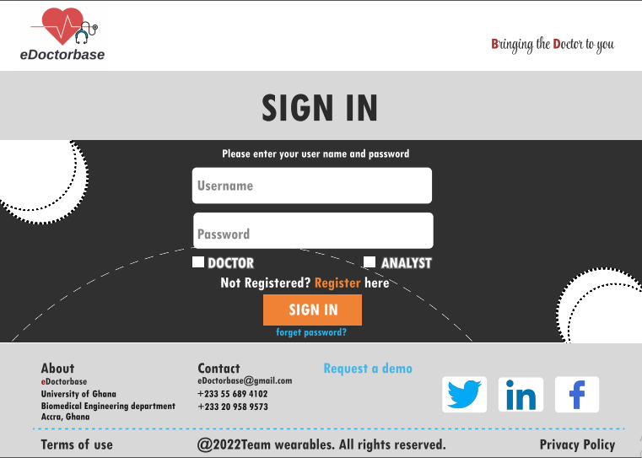
CONCEPTUALIZATION
The web application design concept was made in FIGMA. The concept shows the User Interface and User Experience of the application
User Interface(UI)

Slide 21
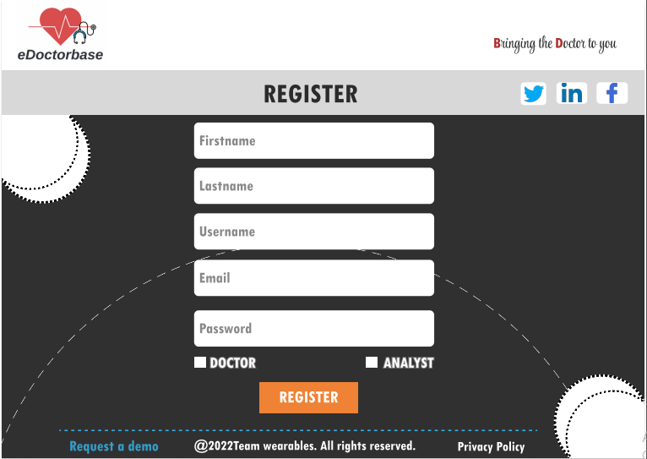
CONCEPTUALIZATION Cont’D
Register Page

Slide 22
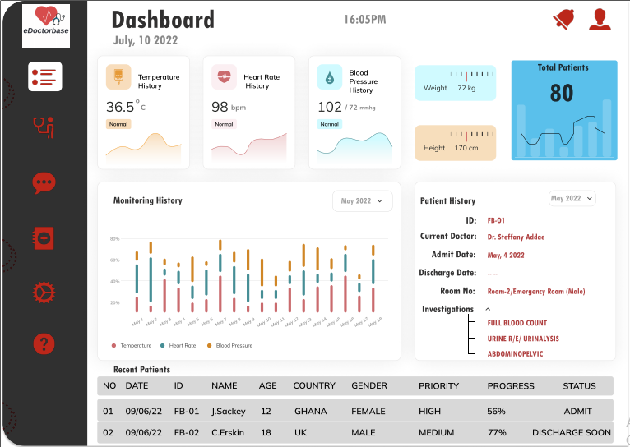
CONCEPTUALIZATION Cont’D
Dashboard Page

Slide 23
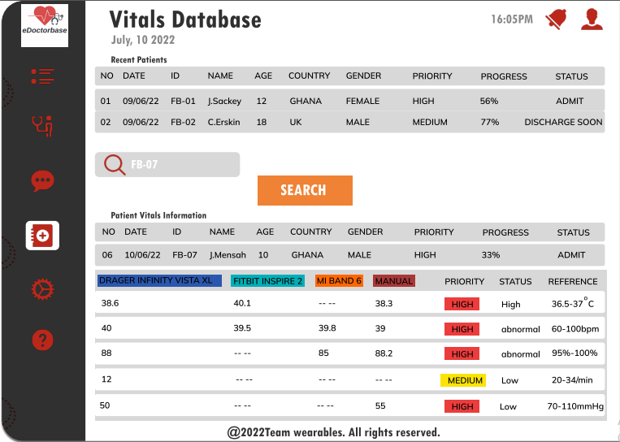
CONCEPTUALIZATION Cont’D
Display of Vitals

Slide 24
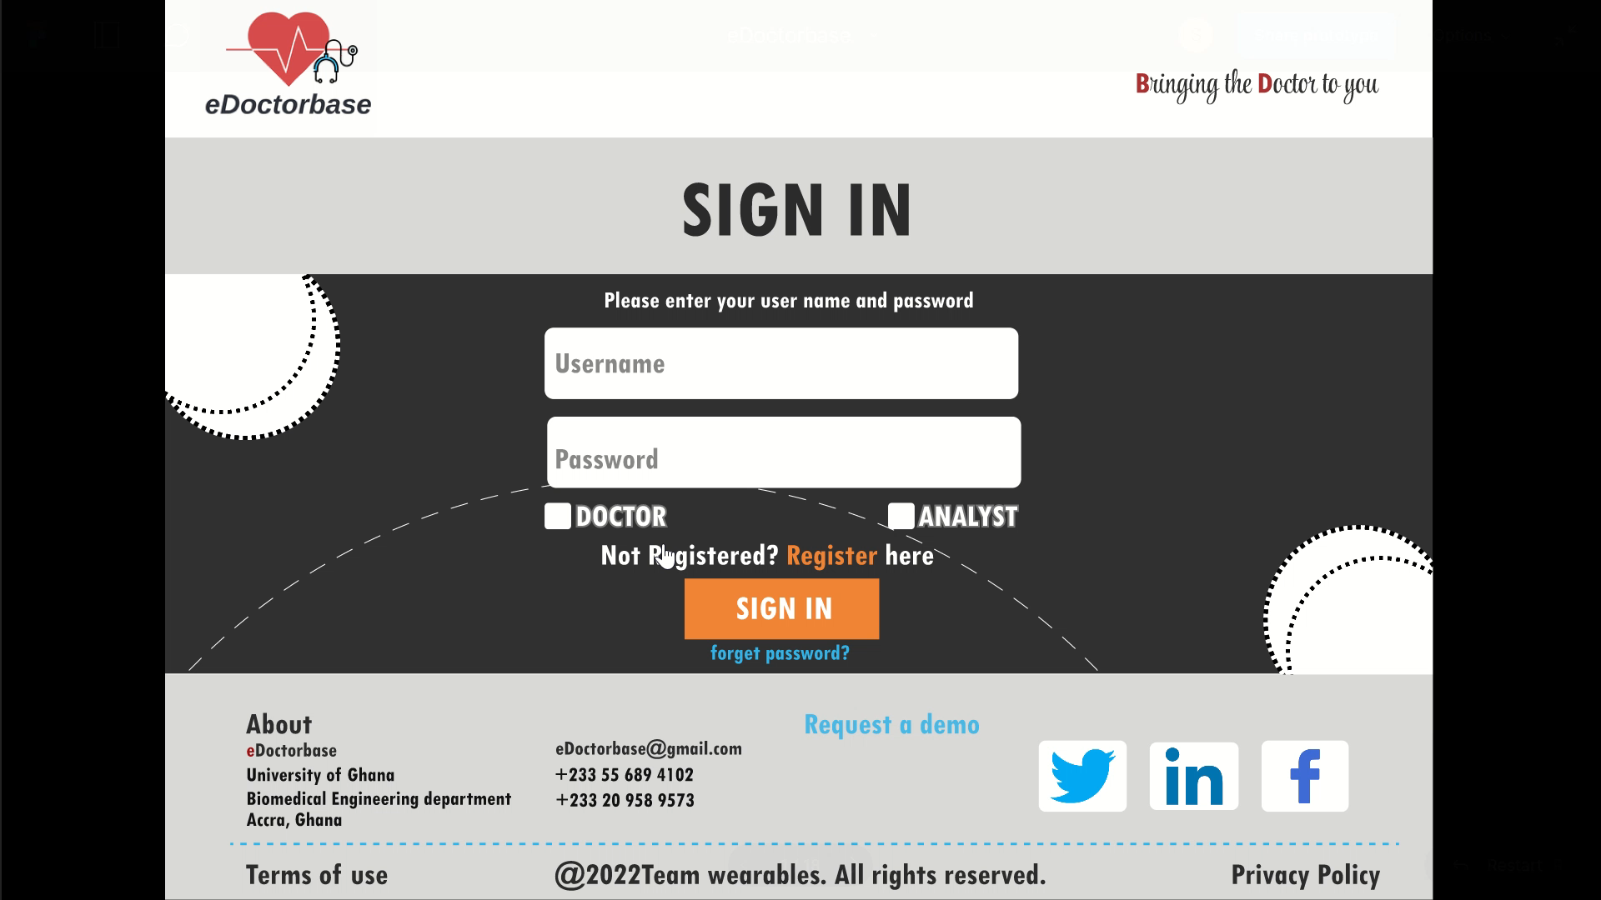
CONCEPTUALIZATION Cont’D
User Experience (UX)

Slide 25
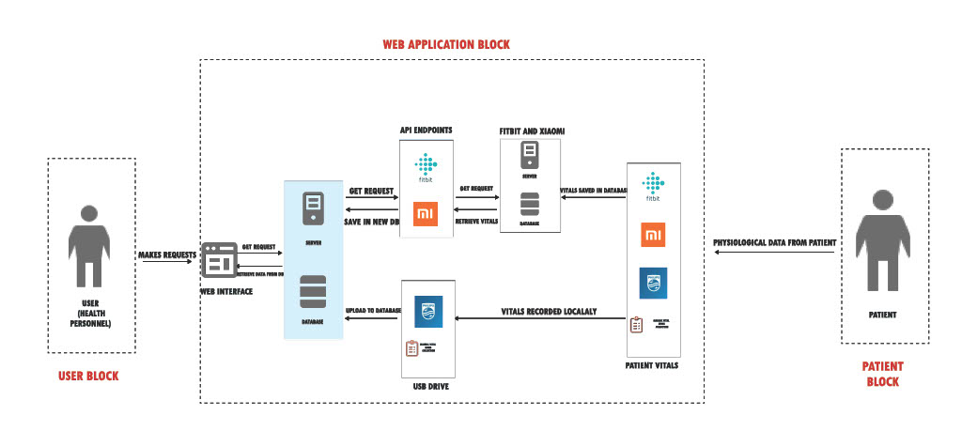
CONCEPTUALIZATION Cont’D
SYTEM ARCHITECTURE

Slide 26
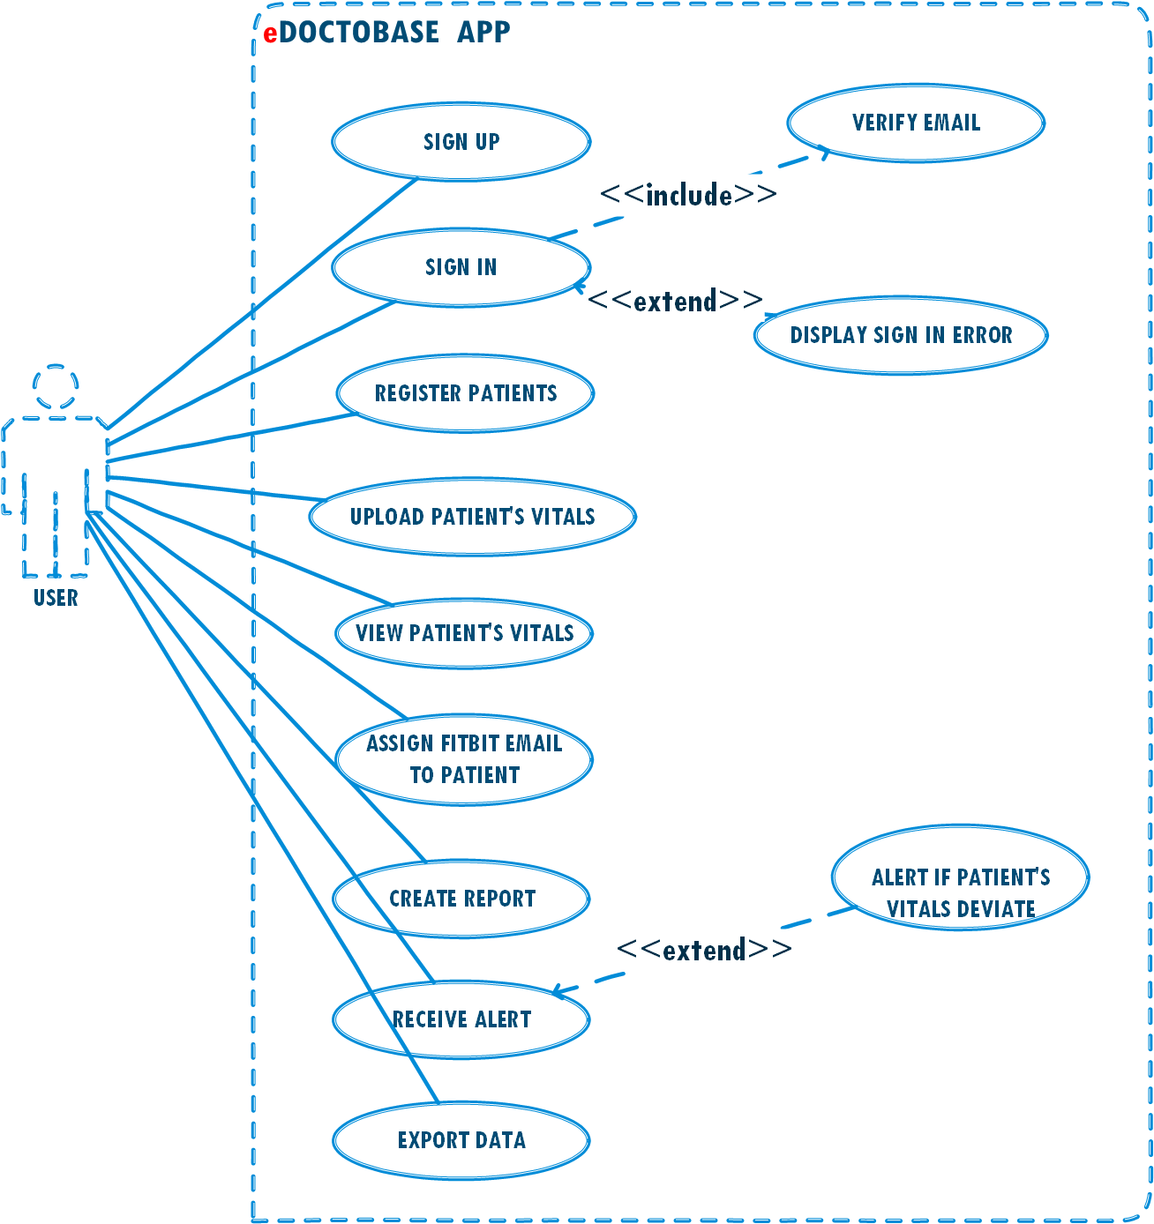
CONCEPTUALIZATION Cont’D
USE CASE DIAGRAM:

Slide 27
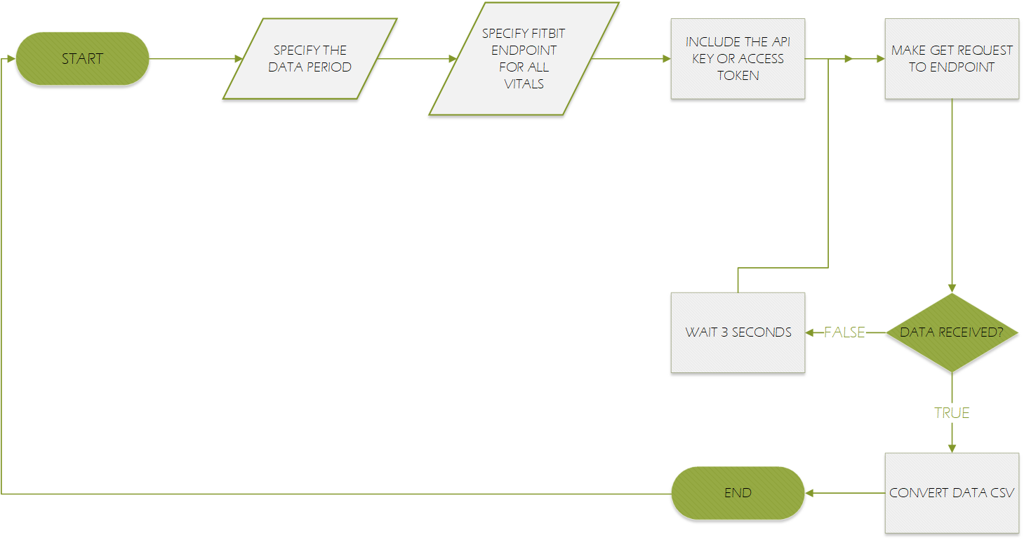
CONCEPTUALIZATION Cont’D
FLOW CHART FOR FITBIT API

Slide 28
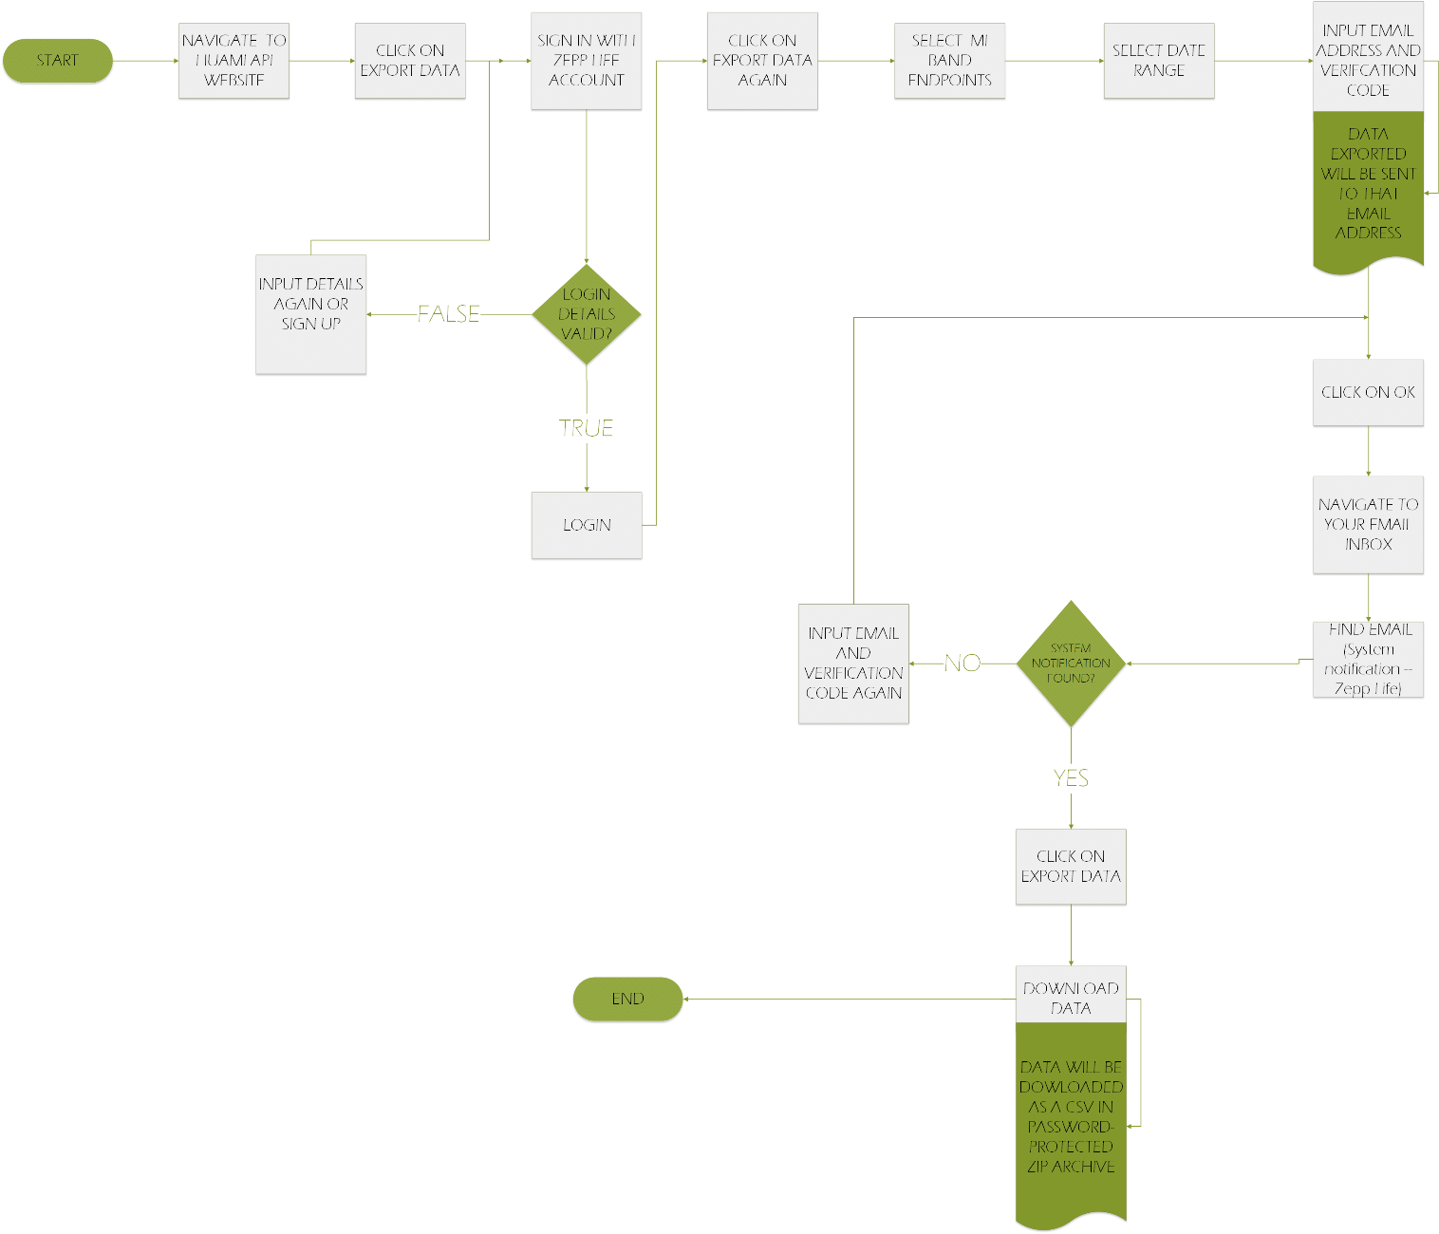
CONCEPTUALIZATION Cont’D
FLOW CHART FOR XIAOMI

Slide 29
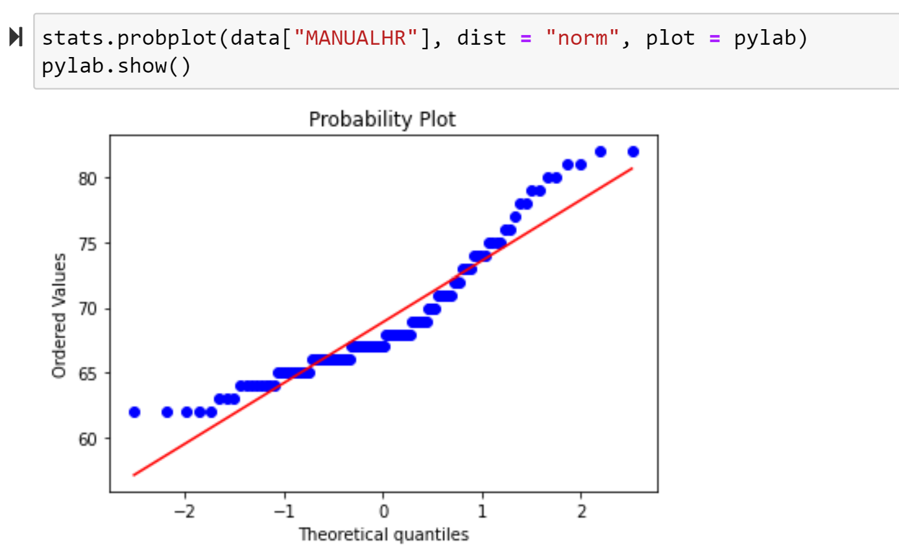
RESULTS – TEST FOR NORMALITY
Quantile-Quantile Plot

Slide 30
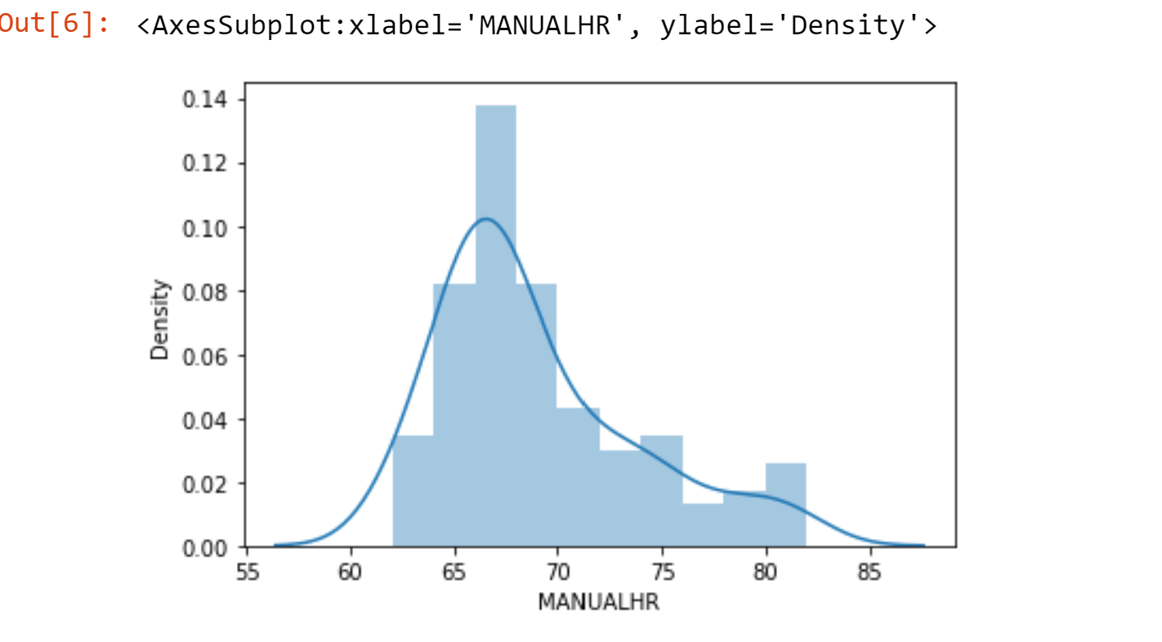
RESULTS – TEST FOR NORMALITY
Histogram Plot

Slide 31
RESULTS – TEST FOR NORMALITY
Shapiro-Wilk Test
VITAL SIGN | P-VALUE | CONCLUSION
Patient monitor heart rate | 1.06x 10⁻¹⁵ | Not normally distributed
Xiaomi heart rate on same day with patient monitor | 1.60x 10⁻¹¹ | Not normally distributed
Fitbit heart rate on same day with patient monitor | 1.34x 10⁻¹⁷ | Not normally distributed
Xiaomi SPO2 data | 8.31x 10⁻¹⁹ | Not normally distributed
Patient monitor SPO2 data | 6.60x 10⁻¹³ | Not normally distributed
Manual heart rate data | 4.22x 10⁻⁷ | Not normally distributed
Xiaomi heart rate on same day with manual monitor | 2.38x 10⁻⁹ | Not normally distributed
Fitbit heart rate on same day with manual monitor | 6.06x 10⁻⁹ | Not normally distributed

Slide 32
RESULTS – STATISTICAL ANALYSIS
The following Correlation Coefficients were recorded
 | PHILIPS Patient monitor heart rate | Manual Monitor Heart rate
Fitbit Heart rate | 0.935949 | 0.825244
Xiaomi Heart rate | 0.749383 | 0.422386

Slide 33
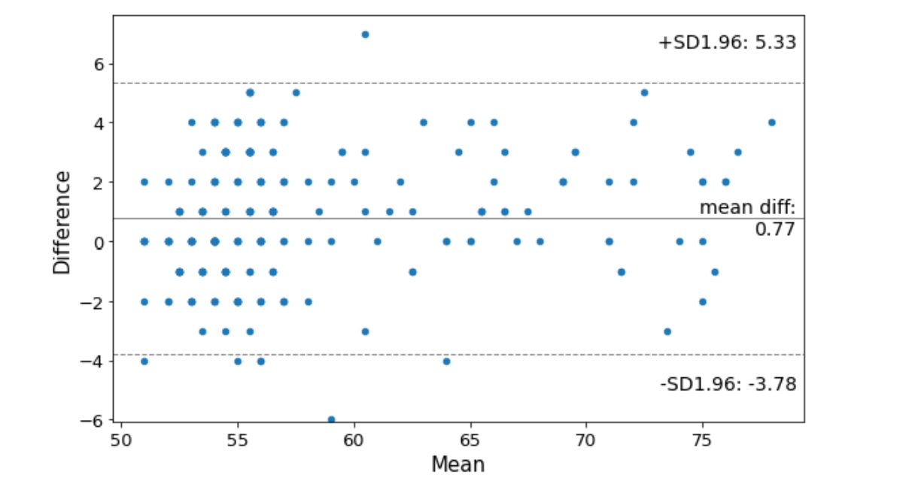
Bland-Altman plot for Fitbit heart rate against patient monitor

Slide 34
RESULTS Cont’D
The bland- Altman analysis produced the results in the table below
 | MEAN DIFFERENCE | LIMITS OF AGREEMENT | OUTLIERS
Fitbit heart rate against patient monitor | 0.77 | -3.78 to 5.33 | 6
Fitbit heart rate against manual monitoring device | -1.56 | -7.23 to 4.11 | 3
Xiaomi heart rate against patient monitor | -0.86 | -10.56 to 8.82 | 15
Xiaomi heart rate against manual monitoring device | -2.12 | -15.07 to 10.83 | 1
Xiaomi SPO2 against patient monitor | -0.33 | -3.47 to 2.81 | 4

Slide 35
RESULTS Cont’D
Accuracy summary of the various measurements (obtained from MAPE)
 | FITBIT HEART RATE DAY1 | FITBIT HEART RATE DAY1 | OVERALL FITBIT HEART RATE | XIAOMI HEART RATE DAY1 | XIAOMI HEART RATE DAY 2 | XIAOMI OVERALL HEART RATE | XIAOMI SPO2 DAY1 | XIAOMI SPO2 DAY2 | OVEARALL SPO2
PATIENT MONITOR | 97.16% | 96.6% | 96.87% | 93.85% | 94.61% | 94.24% | 98.08% | 99.01% | 98.79%
MANUAL MONITOR |  |  | 96.64% |  |  | 93.21%

Slide 36
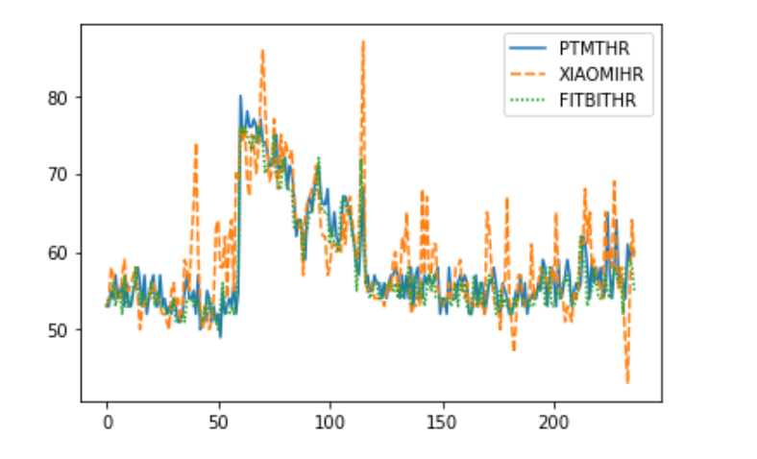
DATA VISUALIZATION
Line plot for wearable devices and patient monitor

Slide 37
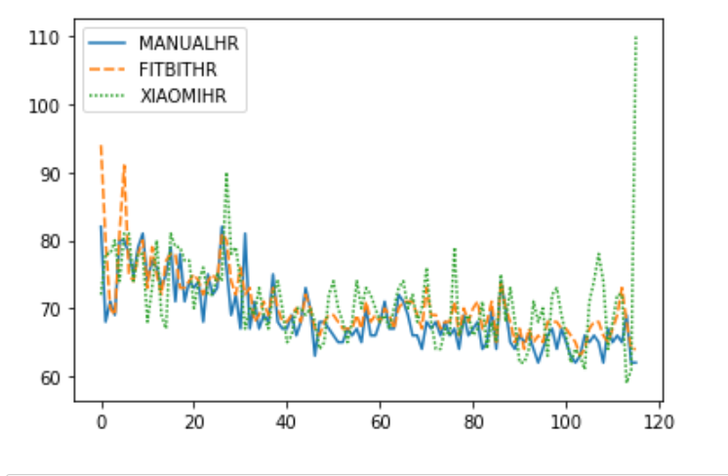
DATA VISUALIZATION
Line plot for wearable devices and manual monitoring device

Slide 38

RESULTS – WEB APPLICATION
SIGN UP PAGE

Slide 39
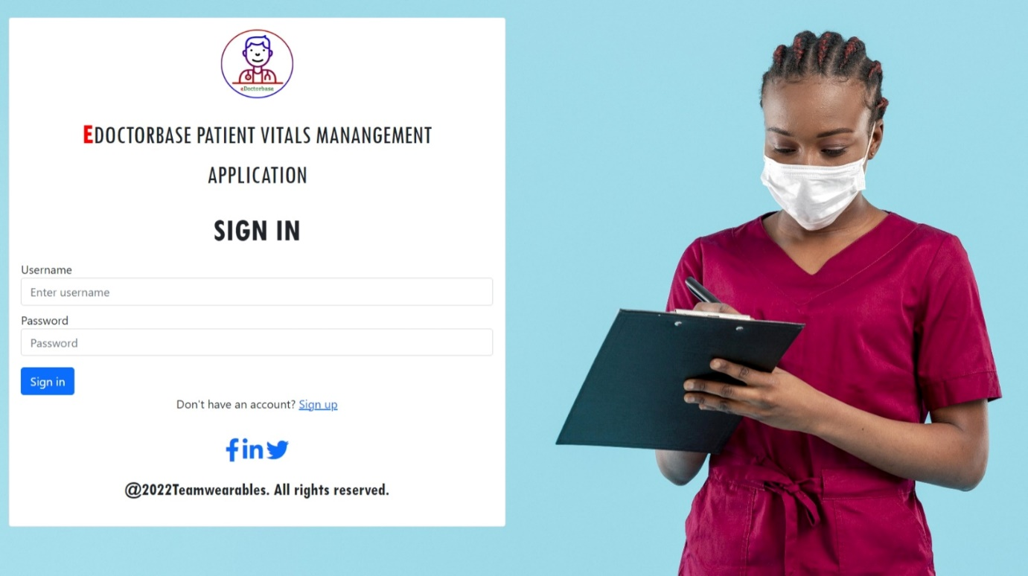
RESULTS – WEB APPLICATION, Cont’D
SIGN IN PAGE

Slide 40
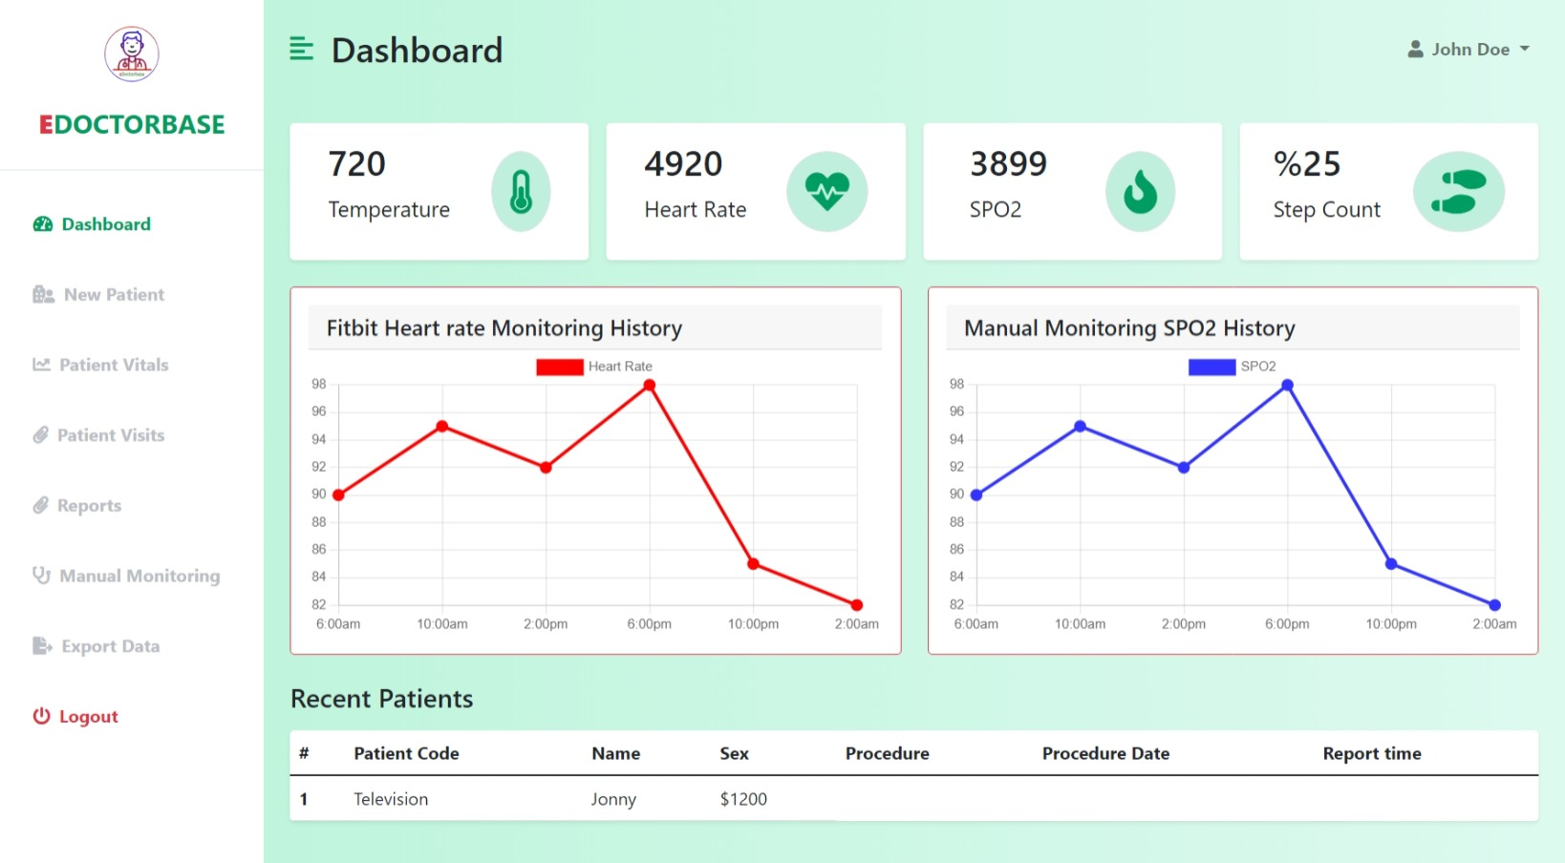
RESULTS – WEB APPLICATION, Cont’D
DASHBOARD

Slide 41
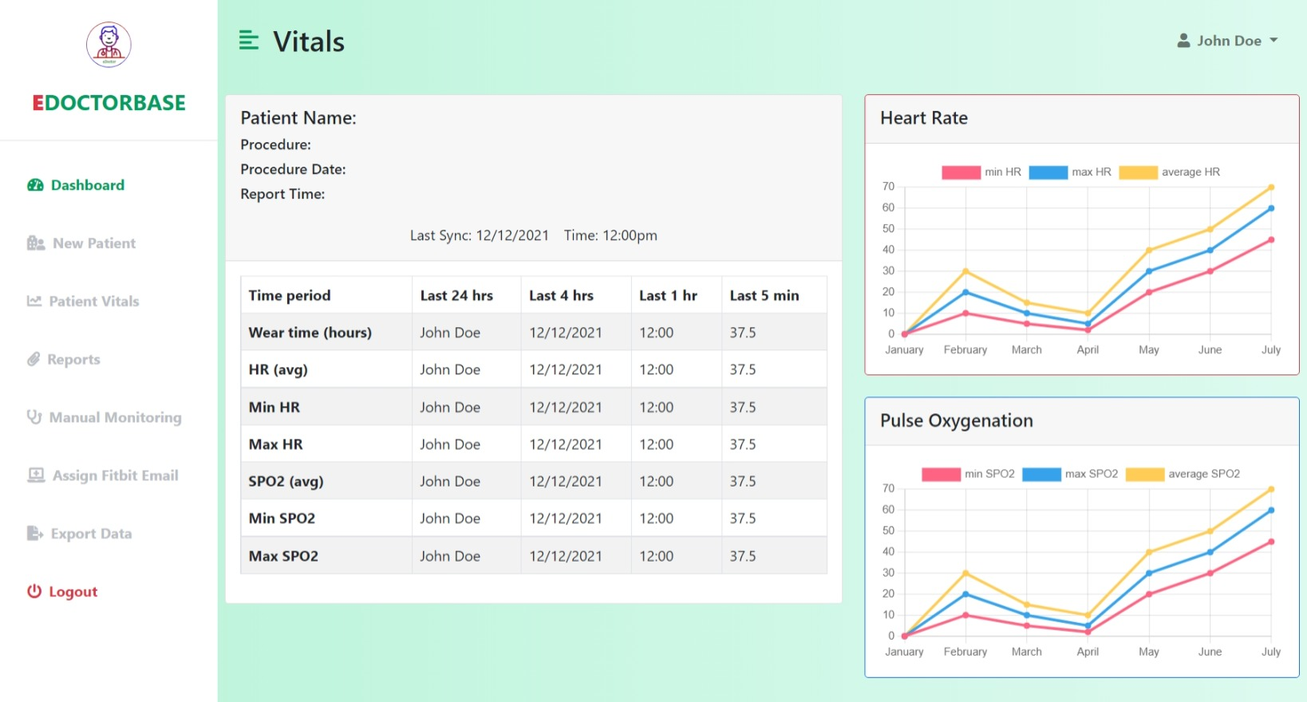
RESULTS – WEB APPLICATION, Cont’D
PATIENT VITAL VISUALIZATION

Slide 42
DISCUSSION
Similar study conducted in literature obtained error estimation between 1% to 9% and limits of agreement between -27.3 to 13.1 bpm for Fitbit heart rate which is less accurate compared to the values gotten in this study (Wallen et al., 2016)
Accuracy of results obtained from the wearable are within the acceptable range (less than 10% of error estimation from the mean absolute percentage error) (Nelson & Allen, 2019).
The Fitbit device outperformed the Xiaomi device during heart rate measurement with reference to both the PHILIPS patient monitor and manual monitoring device
R. Kondama Reddy et al., “Accuracy of wrist-worn activity monitors during common daily physical activities and types of structured exercise: Evaluation study,” JMIR mHealth uHealth, vol. 6, no. 12, 2018, doi: 10.2196/10338.
B. W. Nelson and N. B. Allen, “Accuracy of consumer wearable heart rate measurement during an ecologically valid 24-hour period: Intraindividual validation study,” JMIR mHealth uHealth, vol. 7, no. 3, pp. 1–16, 2019, doi: 10.2196/10828.

Slide 43
CONCLUSION
The two wearable devices used in this study (Fitbit and Xiaomi) proved to be very accurate in measuring vital signs (SPO2 and heart rate).
All two devices achieved values of the mean absolute percentage error (MAPE) to be less than 10% (the generally accepted value of MAPE).
Results of this study can be used to validate and certify these devices to be used alongside the fully functional web application developed by the team in the hospital setting here in Ghana to monitor vital signs of patient in the hospital
Further researches should focus on conducting similar study on patients in the hospital setting instead of using healthy individuals

Slide 44
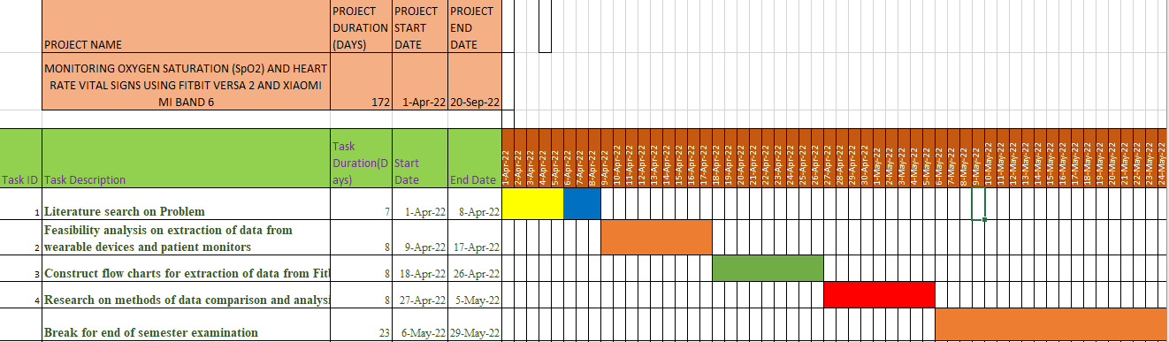
PROJECT TIMELINE

Slide 45
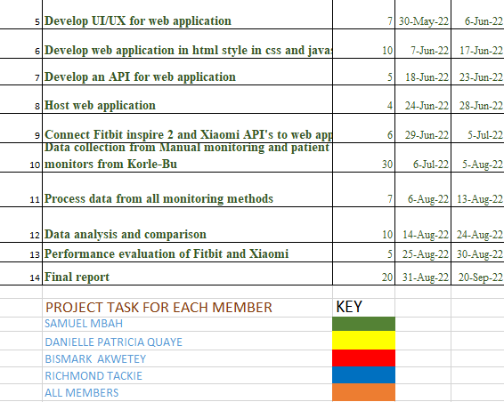
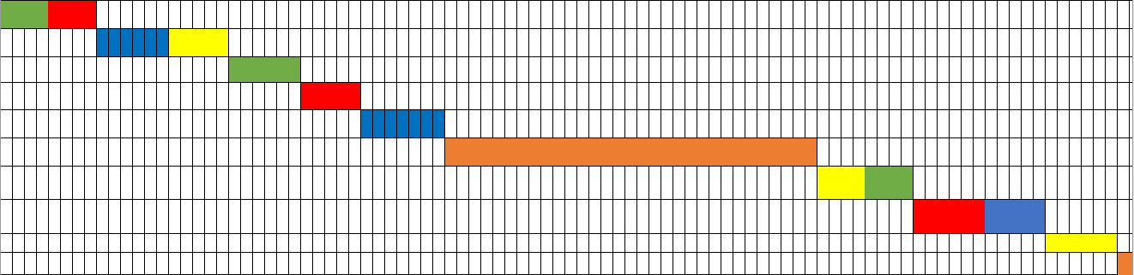
TIMELINE Cont’D

Slide 46
BUDGET
ITEM | FUNCTION | ESTIMATED COST
Pen drives (5) | Data Extraction | GHS 100
Fitbit Versa 2 | Monitoring of Heart rate | Available
Xiaomi Mi Band 6 | Monitoring of Heart rate and SpO2 | Available
Computer | Documentation | Available
Miscellaneous | Project Documentation Transport | GHS 100
 | TOTAL | GHS 200

Slide 47
REFERENCES
Bonnici T. (2019) The sensium monitor; an example of the digital form factor. https://www.researchgate.net/figure/The-Sensium-monitor-an-example-of-the-digital-patch-form-factor_fig4_33868650
Breteler, M. J. M., KleinJan, E. J., Dohmen, D. A. J., Leenen, L. P. H., van Hillegersberg, R., Ruurda, J. P., van Loon, K., Blokhuis, T. J., & Kalkman, C. J. (2020). Vital signs monitoring with wearable sensors in high-risk surgical patients a clinical validation study. Anesthesiology, 3, 424–439. https://doi.org/10.1097/ALN.0000000000003029
B. W. Nelson and N. B. Allen, “Accuracy of consumer wearable heart rate measurement during an ecologically valid 24-hour period: Intraindividual validation study,” JMIR mHealth uHealth, vol. 7, no. 3, pp. 1–16, 2019, doi: 10.2196/10828.
Dias, D., & Cunha, J. P. S. (2018). Wearable health devices—vital sign monitoring, systems and technologies. Sensors (Switzerland), 18(8). https://doi.org/10.3390/s18082414
Di Rienzo, M., Rizzo, F., Parati, G., Brambilla, G., Ferratini, M., & Castiglioni, P. (2005). MagIC system: A new textile-based wearable device for biological signal monitoring. Applicability in daily life and clinical setting. Annual International Conference of the IEEE Engineering in Medicine and Biology - Proceedings, 7 VOLS, 7167–7169. https://doi.org/10.1109/iembs.2005.1616161
Duffy J. (2016) Basis Peak Preview. https://www.pcmag.com/reviews/basis-peak

Slide 48
REFERENCES
Godfrey, A., Hetherington, V., Shum, H., Bonato, P., Lovell, N. H., & Stuart, S. (2018). From A to Z: Wearable technology explained. Maturitas, 113(April), 40–47. https://doi.org/10.1016/j.maturitas.2018.04.012
Home - Sotera Wireless. (n.d.). Retrieved March 26, 2022, from https://www.soterawireless.com/
Jaoo P., Silva C., Bernardo C, Antonio S. (2010) Vital-Jacket®: A wearable wireless vital signs monitor for patients' mobility in Cardiology and Sports. https://eudl.eu/pdf/10.4108/ICST.PERVASIVEHEALTH2010.899
Jung S. (2014) SensoTRACK Fitness Wearable Tracks Activity From Your Ears. https://www.medgadget.com/2014/10/sensotrack-fitness-wearable-tracks-activity-from-your-ears-interview.html
Khan, Y., Ostfeld, A. E., Lochner, C. M., Pierre, A., & Arias, A. C. (2016). Monitoring of Vital Signs with Flexible and Wearable Medical Devices. 4373–4395. https://doi.org/10.1002/adma.201504366

Slide 49
REFERENCES
Medgadget Editors (2012) Visi Mobile System for Real Time Wireless In – Hospital Vital Sign Monitoring. https://www.medgadget.com/2012/08/visi-mobile-system-for-real-time-wireless-in-hospital-vital-signs-monitoring-video.html
Medical EXPO (n.d) ECG patient monitor. https://medicalexpo.com
Weenk, M., van Goor, H., Frietman, B., Engelen, L. J. L. P. G., van Laarhoven, C. J. H. M., Smit, J., Bredie, S. J. H., & van de Belt, T. H. (2017). Continuous monitoring of vital signs using wearable devices on the general ward: Pilot study. JMIR MHealth and UHealth, 5(7), 1–15. https://doi.org/10.2196/mhealth.7208
Raleigh N. (2021) Valencell Expands World’s First Calibration- free, cuffless blood pressure monitoring system. https://valencell.com/press/valencell-expands-worlds-first-calibration-free-cuffless-blood-pressure-monitoring-system-to-the-finger-and-wrist/
R. Kondama Reddy et al., “Accuracy of wrist-worn activity monitors during common daily physical activities and types of structured exercise: Evaluation study,” JMIR mHealth uHealth, vol. 6, no. 12, 2018, doi: 10.2196/10338

Slide 50
DEMONSTRATION

Slide 51
Thank You!

